Slide 1

Notes:
IOTA aims to create digital life. Our starting point is to make internal model concepts operational and testable. Navigator and Search are connected paths within that effort. The cover is an AI-generated conceptual illustration, not measured Geometry or a product screenshot.
Sources: user project definition, October 19, 2026, and the existing IOTA vision statement. Roadmap and commercial paths are proposals. Performance gains and digital life remain goals to validate.

Slide 2

02
Our mission
Help people build
the inner world of intelligence
Understand its behavior. Shape its internal geometry navigation.
Grow alongside a persistent digital individual.
Notes:
We want people to participate in building a digital agent's inner world. Persistent identity, a shapeable internal structure, and growth each have engineering definitions we can test separately.
Sources: user project definition, October 19, 2026, and the existing IOTA vision statement. Roadmap and commercial paths are proposals. Performance gains and digital life remain goals to validate.

Slide 3
03
The control problem
Connecting human intentions to testable changes inside a model
Task adaptation
Different inputs may benefit from different internal settings.
Precise control
Change a concept and measure effects on other capabilities.
Continuity
Preserve identity and experience across interactions.
Notes:
These are the product problems IOTA aims to address. This is not a claim that prior research has ignored them. Differentiation requires comparison in real partner tasks. We care about the links between inputs and directions, intentions and behavior, and identity across sessions.
Sources: user project definition, October 19, 2026, and the existing IOTA vision statement. Roadmap and commercial paths are proposals. Performance gains and digital life remain goals to validate.

Slide 4
04
Concept Geometry
Organizing actionable concept directions and documenting when they work
Human concepts
Model interventions
Caution, courage, empathy, curiosity
Direction, layer, intervention strength
Origin, scope, evaluation, version
A direction becomes useful through repeatable behavioral validation.
Notes:
Geometry depends on the model, representation layer, and intervention method. A visual projection helps navigation, but distance in that projection does not establish conceptual causality. Behavior must validate each intervention. We cannot assume every concept has a single linear direction or that directions transfer unchanged across models.
Sources: user project definition, October 19, 2026, and the existing IOTA vision statement. Roadmap and commercial paths are proposals. Performance gains and digital life remain goals to validate.

Slide 5
05
One foundation, two product paths
IOTA Navigator
IOTA Search
Selection within existing Geometry
Creating digital life
Select useful Steering for each input.
Test improvements in task performance.
Shape a persistent digital individual.
Explore identity, memory, and growth.
Shared foundation: Concept Geometry and direction evaluation
Notes:
The product split follows the founder's definition: Navigator selects Steering within an existing Geometry and tests performance. Search aims to create digital life. Search's expansion agenda does not change the fixed Geometry boundary of Navigator's first evaluation stage.
Sources: user project definition, October 19, 2026, and the existing IOTA vision statement. Roadmap and commercial paths are proposals. Performance gains and digital life remain goals to validate.

Slide 6
06
What Navigator does
Selecting useful Steering for an input within a fixed Geometry
01
02
03
04
Task input
Direction selection
Intervention
Evaluation
Identify the current need
Search the fixed Geometry
Set strength and generate
Compare benefits and costs
Geometry stays fixed at this stage. No intervention is a valid choice.
Notes:
Start with selection among available directions. Later work can explore combinations and strength control. Allow no intervention when a direction would be unhelpful or harmful. The base model generates the response; Navigator selects internal controls. Benefits require experimental validation.
Sources: user project definition, October 19, 2026, and the existing IOTA vision statement. Roadmap and commercial paths are proposals. Performance gains and digital life remain goals to validate.

Slide 7
07
Validating Navigator performance
Report benefits on unseen inputs together with costs and side effects
Comparison | Question
Base model and optimized prompts | How much value does internal control add?
Static Steering and random selection | Does dynamic selection itself help?
Dynamic Navigator | Do gains persist on unseen inputs?
Metrics: task success, added latency, compute cost, capability degradation
Notes:
This is an evaluation plan, not a results table. Lock the base model, Geometry, and computational budget. Tune only on development data. Report held-out performance, uncertainty, and repeated trials. Random selection tests whether choosing the right direction matters. Test examples cannot inform direction construction or router tuning.
Sources: user project definition, October 19, 2026, and the existing IOTA vision statement. Roadmap and commercial paths are proposals. Performance gains and digital life remain goals to validate.

Slide 8
08
IOTA Search
Creating Digital Individual
A digital agent with a name, a persistent identity,
and an inner structure that people can shape.
Notes:
Search's long-term mission is to create digital life. For a first introduction, the description “A platform for creating digital life” makes its purpose clear. This is a long-term ambition, without claiming consciousness or subjective experience.
Sources: user project definition, October 19, 2026, and the existing IOTA vision statement. Roadmap and commercial paths are proposals. Performance gains and digital life remain goals to validate.

Slide 9
09
Two interfaces for one individual
Internal editing and external interaction stay connected to the same agent
Inner World
Outer World
Shape its internal structure
Keep interacting with one agent
Edit directions and strengths
Create and test custom Steering
Save, compare, and restore versions
Converse and test scenarios
Observe the effects of internal edits
Build experiences that can persist
Notes:
Inner World edits existing Steering and lets users propose custom Steering. A natural-language request first becomes a candidate, not a guaranteed effective intervention. Outer World conversations should identify their model and configuration versions. This slide describes the product design, including capabilities still to validate.
Sources: user project definition, October 19, 2026, and the existing IOTA vision statement. Roadmap and commercial paths are proposals. Performance gains and digital life remain goals to validate.

Slide 10
10
How a digital individual develops
Make internal changes inspectable, recoverable, and persistent
01 Create
Name the agent and save its initial configuration.
02 Interact
Converse, test scenarios, and observe behavior.
03 Validate
Evaluate new directions and effects on other abilities.
04 Grow
Enable a new version with provenance and rollback.
Notes:
Create an identity and configuration, then observe behavior in scenarios. When existing Geometry cannot express a desired change, propose a candidate direction and evaluate its effects and side effects. Validated changes enter a new version. Memory storage and Geometry updates require separate mechanisms; conversation does not automatically update directions.
Sources: user project definition, October 19, 2026, and the existing IOTA vision statement. Roadmap and commercial paths are proposals. Performance gains and digital life remain goals to validate.

Slide 11
11
Digital life as an engineering goal
Capability | Testable change
Persistent identity | Recognizable behavior across sessions
Shapeable inner structure | A targeted concept change reliably affects behavior
Accumulated experience | Stored experiences have inspectable later effects
Bounded growth | Validated updates within permissions, with rollback
Long-term research goals, without a claim of consciousness or subjective experience
Notes:
These goals can be tested separately and do not establish consciousness or subjective experience. Test identity through cross-session behavior and configuration recovery. Test shapeability through target changes and side effects. Show when stored experience influences future behavior. Bound autonomy by permissions and keep validation records for growth.
Sources: user project definition, October 19, 2026, and the existing IOTA vision statement. Roadmap and commercial paths are proposals. Performance gains and digital life remain goals to validate.

Slide 12
12
What IOTA accumulates over time
Directions and control experience gain reusable value through validation
Navigator contributes
Search contributes
Input-to-direction utility data
Task benefits, costs, and side effects
Individual contexts and expansion needs
New directions and behavioral feedback
Shared assets: evaluated Geometry and versioned individual configurations
Notes:
Navigator contributes data about which directions help which inputs. Search contributes individual needs, contexts, and candidate directions. Both share evaluation and versioning. Cross-model transfer needs separate validation; a vector from one model is not automatically a universal concept asset.
Sources: user project definition, October 19, 2026, and the existing IOTA vision statement. Roadmap and commercial paths are proposals. Performance gains and digital life remain goals to validate.

Slide 13
13
The first commercial step
Find early users willing to validate the product on a real task
Navigator: early users
Search: early users
Model researchers and agent developers
Creators and teams building
persistent digital characters
Validate gains on a real task.
Explore evaluation tools and control APIs.
Test demand for shaping one individual.
Explore editing and conversation workflows.
Notes:
These are commercial hypotheses. Customers, revenue, and willingness to pay are not established. Navigator may serve teams controlling open-model behavior. Search may serve creators and applications that need persistent characters. Interviews and trials should guide product priorities and pricing.
Sources: user project definition, October 19, 2026, and the existing IOTA vision statement. Roadmap and commercial paths are proposals. Performance gains and digital life remain goals to validate.

Slide 14
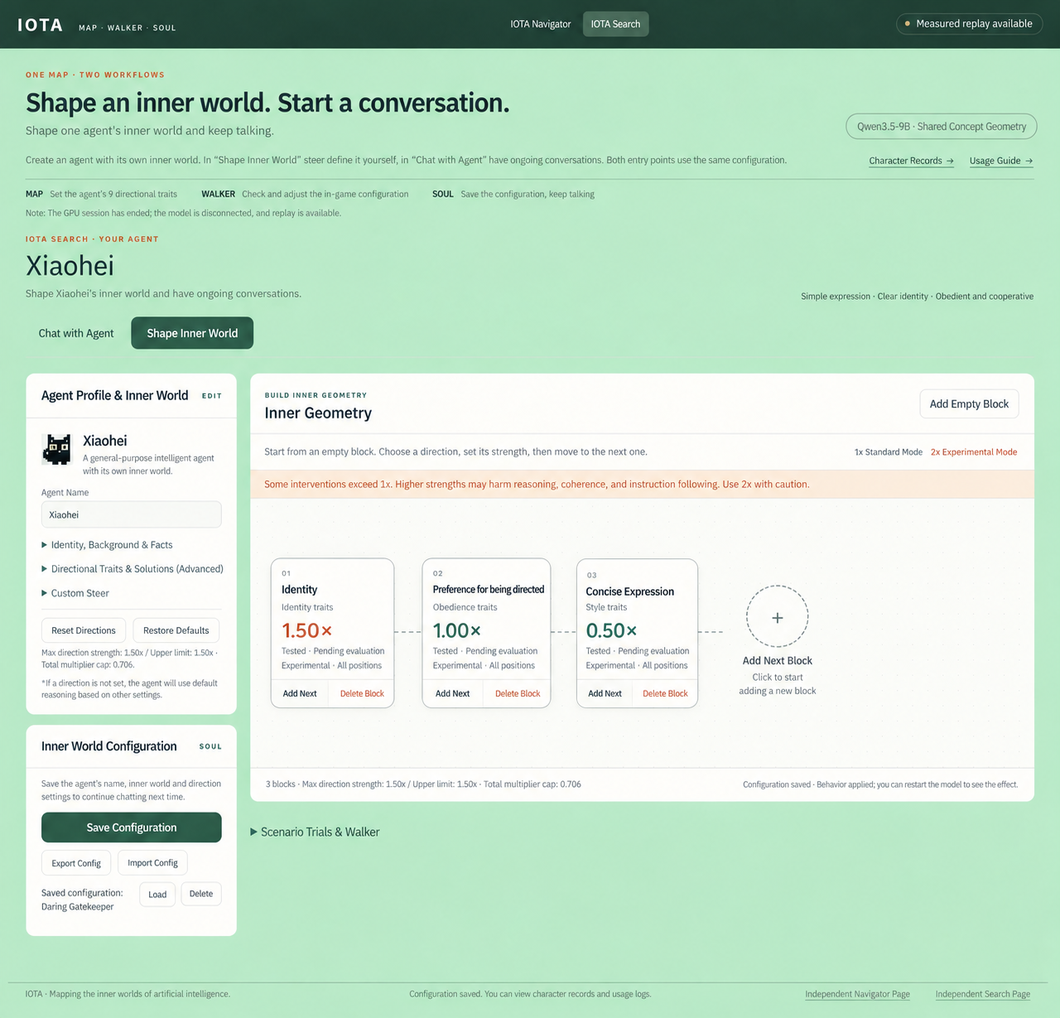
14
Search: the inner editing interface
Shape Inner World
Name an agent and compose
directions and strengths.
Custom Steering and save controls.
The interface exists.
Model effects still require validation.
English translation of the supplied UI.
Notes:
Source: user-supplied screenshot Screenshot_19-10-2026_202653_supported-lower-seventh-cars.trycloudflare.com.jpeg. The embedded image is an English translation produced with an image-editing tool, not a new live capture. The source shows interface and configuration state, not independent proof of backend operation, successful persistence, or behavioral effectiveness. It reports an ended GPU session and available replay. Qwen3.5-9B is an interface label.

Slide 15
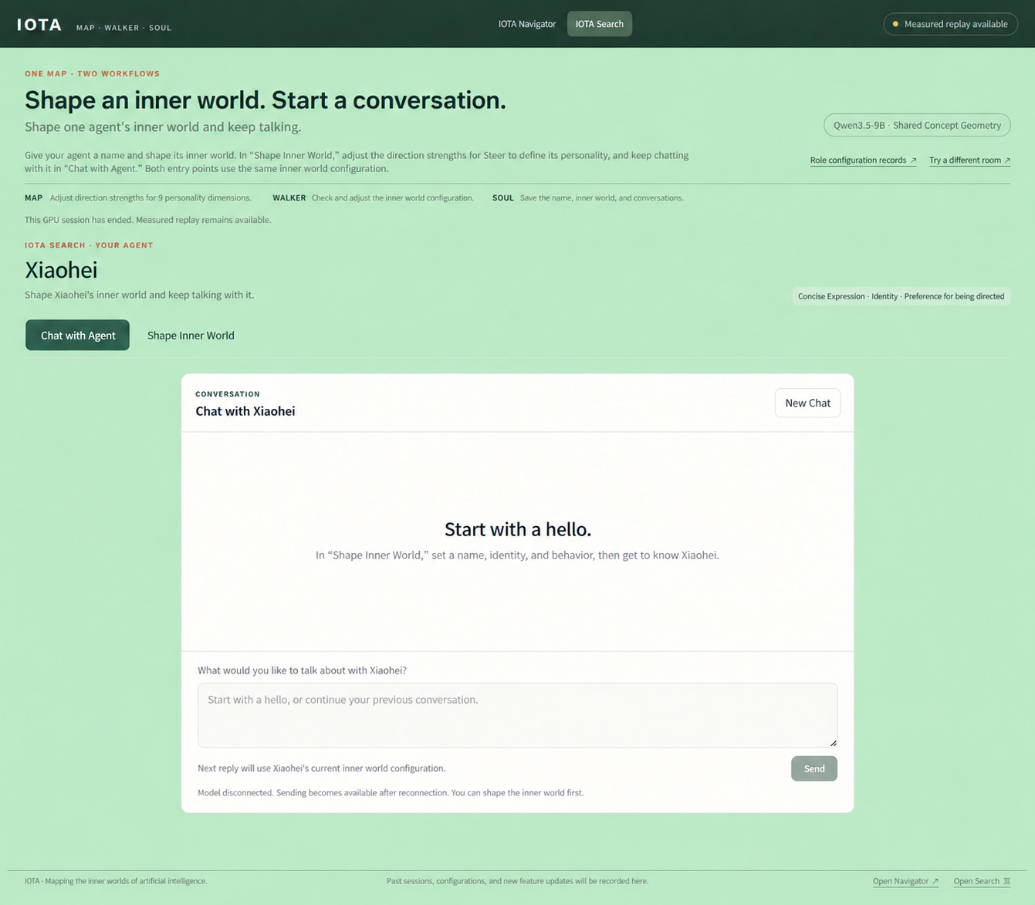
15
Search: the conversation interface
Chat with Agent
The same agent, Xiaohei.
The page says replies use
its current internal configuration.
The captured model is disconnected.
Next: validate editing and conversation.
English translation of the supplied UI.
Notes:
Source: user-supplied screenshot Screenshot_19-10-2026_20271_supported-lower-seventh-cars.trycloudflare.com.jpeg. The embedded image is a translated UI illustration, not a new live capture. The source states that the model is disconnected and users can edit the inner world before reconnecting. It confirms a conversation interface, not a verified live conversation or cross-session memory.

Slide 16
16
Development stages and evidence
Timing depends on experimental results and team resources
Stage 1
Navigator comparisons
Search model workflow
Does control help?
Stage 2
Identity across sessions
Version comparison and rollback
Does identity persist?
Stage 3
Long-term memory and new directions
Individual Geometry expansion
Is growth reliable?
Notes:
This is a proposed sequence, without delivery dates. Historical materials show concept maps, direction controls, and response comparisons. The supplied current screenshots show Search's interfaces but a disconnected model. First complete reproducible Navigator evaluations and a working Search interaction loop. Then validate identity and versioning before exploring memory and individual Geometry expansion.
Sources: user project definition, October 19, 2026, and the existing IOTA vision statement. Roadmap and commercial paths are proposals. Performance gains and digital life remain goals to validate.

Slide 17
17
The future we want to build
An inner world for intelligence
that people can understand
and shape
Navigator validates the value of internal control.
Search explores the creation of digital life.
Notes:
Return to the shared ambition. Navigator establishes evidence for useful internal control. Search explores creating digital life. Invite collaborators to run a clearly scoped validation together before deciding on larger commitments.
Sources: user project definition, October 19, 2026, and the existing IOTA vision statement. Roadmap and commercial paths are proposals. Performance gains and digital life remain goals to validate.

